Slide 1

Internship Review
Review 1
Presented by
Partha BP
24th March 2025
RNSIT Bengaluru
1

Slide 2
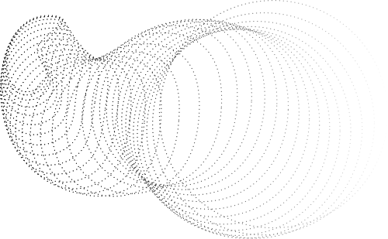

Discussion Points
AN OVERVIEW OF OUR GOALS, OUR PROGRESS,
AND EXPANSION PLANS
Introduction
Progress
Current Status
What's Next?
2

Slide 3
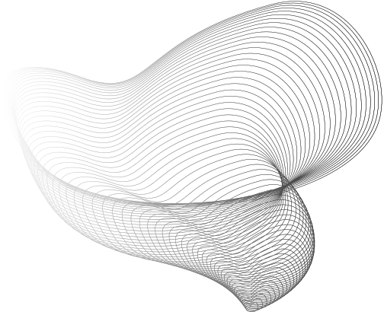
Introduction
UNDERSTANDING LARGE LANGUAGE MODELS
WHY ARE THEY IMPORTANT?
WHAT ARE LLMS? AND HOW DO THEY WORK?
AI models trained on vast datasets to generate , understand images , handle multi-modal dataset and understand human-like text.
Examples: OpenAI's GPT-4o, Meta's Llama 3, Anthropic's Claude 3.
Use transformer-based architectures.
Transform tokens using self-attention mechanisms.
Power chatbots, summarization, translation, and content generation, classification , copilot code generation etc.
Enable automation and enhance AI-driven decision-making.
3

Slide 4
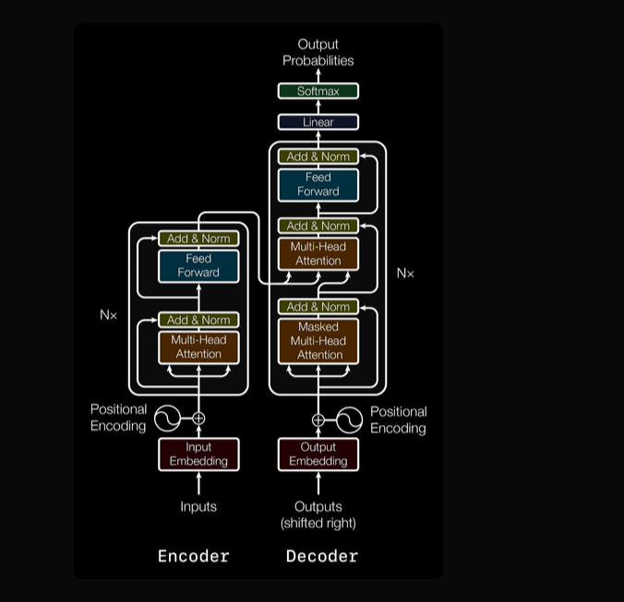

Architecture
The transformer architecture proposed in [Vaswani et al. 2017].
Based on the encoder-decoder ,encoder-only, decoder-only transformer architecture.
Uses self-attention mechanisms to process text efficiently.
Works with feed-forward neural networks for the predictions.
Key Components:
Tokenization: Breaks input text into smaller tokens for processing.
Positional Encoding: Helps the model understand word order.
Input embedding: in transformers converts tokens into dense vector representations, capturing semantic meaning before processing through self-attention layers.
Layer Normalization & Feed-Forward Layers: Improve model stability and efficiency.
4

Slide 5
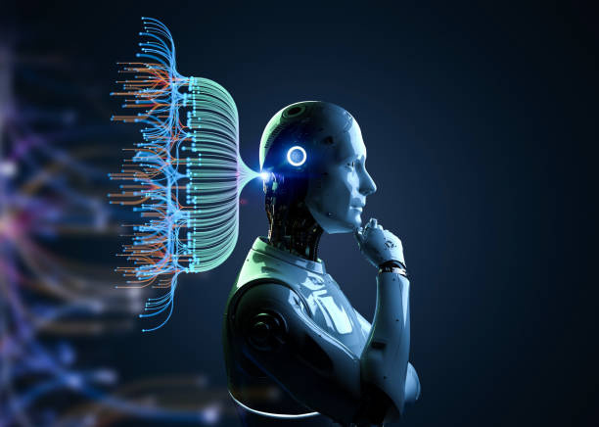
Where Are We?
OUR PROGRESS VS. OUR GOALS
5

Slide 6
Progress so far
RESEARCH AND IMPLEMENTATION
IMPLEMENTATION IDEAS
RESEARCH & STUDY
Completed an NLP course to strengthen understanding of text processing.
Studied different model architectures, training methods, and optimizations.
Explored existing literature on LLMs like Phi, Mistral, Pythia, and Qwen from Hugging Face.
Investigating model compression and quantization techniques to improve performance on edge devices.
Studying low-latency inference strategies for better token processing speed.
Exploring framework compatibility for LLM deployment in a distributed environment.
6

Slide 7

Current Status
StudyING COMMUNICATION PROTOCOLS
HARDWARE SETUP
FRAMEWORKS & IMPLEMENTATION
Jetson Orin Module – ARM-based architecture, optimized for AI workloads.
H61 ATX Motherboard – AMD64-based system for additional processing power.
Addressing differences between RISC (Jetson) and CISC (AMD64) architectures.
Researching gRPC and TCP/IP for seamless hardware communication.
Understanding latency issues and optimizing data transfer.
Deeper understanding how gRPC is used for communication between the devices.
Established inter-device connectivity for data exchange.
Experimenting with model execution strategies on Jetson and other hardware.
Debugging performance bottlenecks in distributed inference.
7

Slide 8
Challenges Faced
Hardware Compatibility Issues:
Differences between ARM (Jetson) and AMD64 (H61 ATX Motherboard)
Performance limitations on edge devices
Communication Delays:
Latency issues in gRPC and TCP/IP communication
Synchronization challenges in distributed inference
Model Optimization:
Memory constraints on Jetson while running large models
Maintaining accuracy vs. speed trade-off with quantization
8

Slide 9
Whats next?
NEXT STEPS AND GOALS
LLM Integration into Distributed Architecture
Deploy models across Jetson and high-power systems
Optimize load balancing for inference
AI-based Applications
Implement summarization, Q&A, and intelligent text processing
Enhance real-time AI performance
Optimizing Communication
Reduce gRPC and TCP/IP latency
Test different message-passing techniques
9

Slide 10

Project Summary
CONCLUSION
This internship focused on understanding, optimizing, and implementing LLMs in a distributed environment.
Researched LLM architectures (Phi, Mistral, Pythia, Qwen) and their real-world applications.
Established communication between multiple devices using gRPC and TCP/IP for distributed processing.
Optimized LLM inference by studying quantization, low-latency strategies, and load balancing.
Implemented key AI functionalities such as text summarization and Q&A to improve real-time response.
ACKNOWLEDGMENTS
Thanks to CDOT, mentors, and project guides
Gratitude to team members and contributors
10

Slide 11
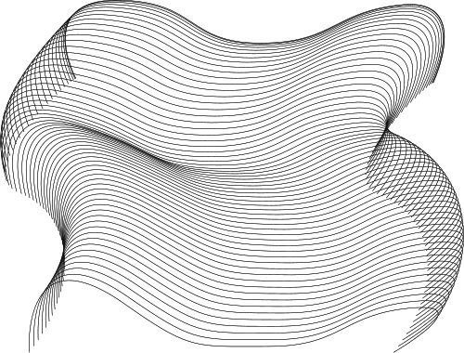
References
Vaswani, A., Shazeer, N., Parmar, N., Uszkoreit, J., Jones, L., Gomez, A. N., & Polosukhin, I. (2017). Attention is all you need. arXiv preprint arXiv:1706.03762. https://arxiv.org/abs/1706.03762
Devlin, J., Chang, M. W., Lee, K., & Toutanova, K. (2018). BERT: Pre-training of deep bidirectional transformers for language understanding. arXiv preprint arXiv:1810.04805. https://arxiv.org/abs/1810.04805
Radford, A., Narasimhan, K., Salimans, T., & Sutskever, I. (2019). Language models are unsupervised multitask learners. OpenAI. https://cdn.openai.com/better-language-models/language_models_are_unsupervised_multitask_learners.pdf
Jurayj, W., Cheng, J., & Van Durme, B. (2025). Is that your final answer? Test-time scaling improves selective question answering. arXiv preprint arXiv:2502.13962. https://arxiv.org/abs/2502.13962
Chen, Y., Xu, L., & Zhan, J. (2024). HeadInfer: Memory-efficient LLM inference by head-wise offloading. arXiv preprint arXiv:2502.12574. https://arxiv.org/abs/2502.12574
Wang, Z., & Zhou, Z. (2024). More agents is all you need. arXiv preprint arXiv:2402.05120. https://huggingface.co/papers/2402.05120
Google. (n.d.). gRPC: A high-performance, open-source universal RPC framework. https://grpc.io/docs/
Paszke, A., Gross, S., Massa, F., Lerer, A., Bradbury, J., Chanan, G., ... & Chintala, S. (2019). PyTorch: An imperative style, high-performance deep learning library. arXiv preprint arXiv:1912.01703. https://arxiv.org/abs/1912.01703
NVIDIA. (n.d.). CUDA: Compute unified device architecture. NVIDIA Developer. https://developer.nvidia.com/cuda-zone
Zhang, Y., Wang, R., & Li, H. (2024). Think twice before assure: Confidence estimation for large language models. arXiv preprint arXiv:2403.09972. https://arxiv.org/abs/2403.09972
Xu, J., Huang, C., & Chen, W. (2021). Confidence score: The forgotten dimension of object detection performance. Sensors, 21(13), 4350. https://www.mdpi.com/1424-8220/21/13/4350
11

Slide 12

Thank you!

